Slide 1
Data Mining: Concepts and Techniques (3rd ed.) — Midterm Review —
Slides Courtesy of Textbook
1
Notes:
1

Slide 2
Sample Exam
Question 3
Question 4

Slide 3
Sample Exam: Question 3
We have 4 base cells, where ai ≠ bi, ∀i = 1,2,3,4.
(a1,a2,a3,b4,a5,...,a10)
(a1,a2,b3,a4,a5,...,a10)
(a1,b2,a3,a4,a5,...,a10)
(b1,a2,a3,a4,a5,...,a10)
There is no concept hierarchy in each dimension.

Slide 4
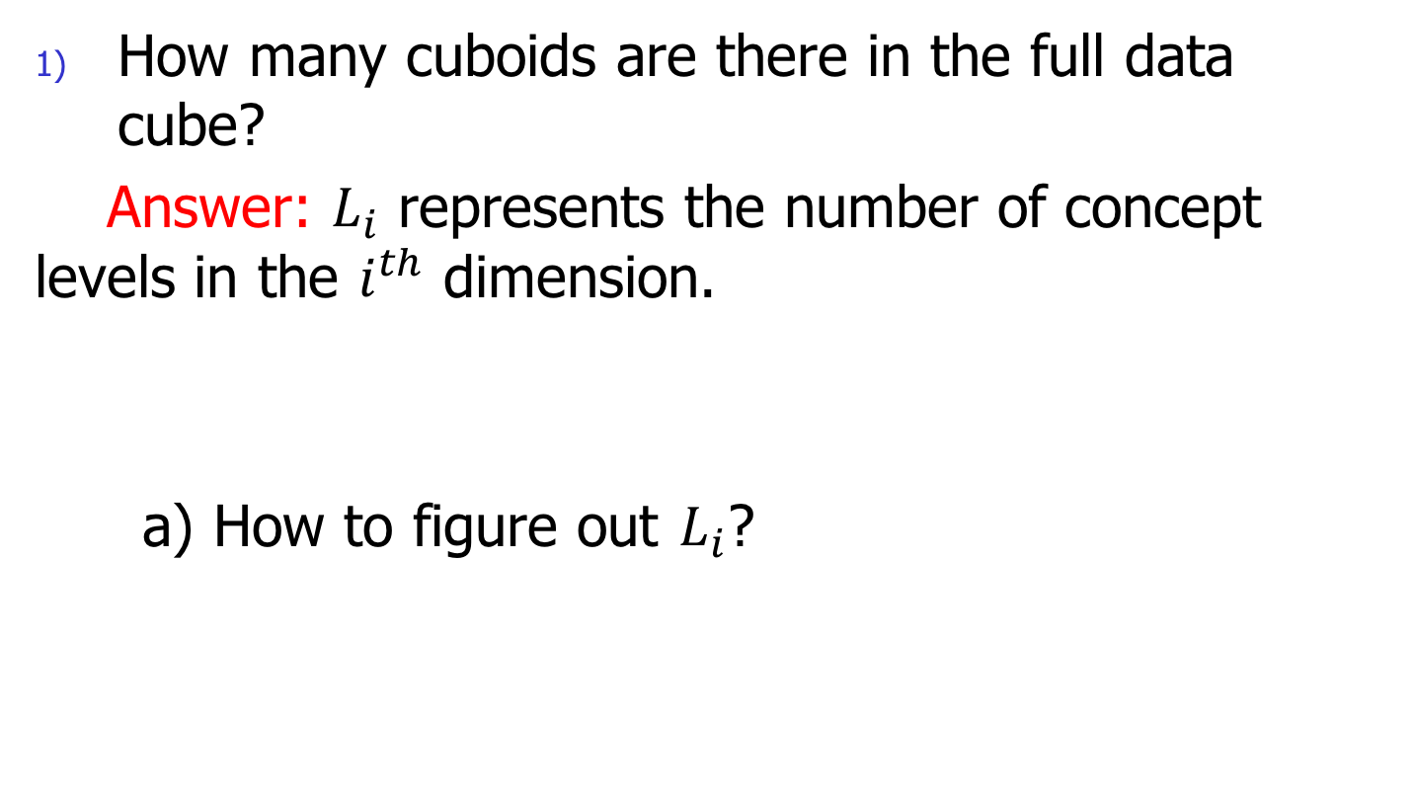
Sample Exam: Question 3
How many cuboids are there in the full data cube?
Answer: $L_{i}$ represents the number of concept levels in the $i^{th}$ dimension.
a) How to figure out $L_{i}$?

Slide 5
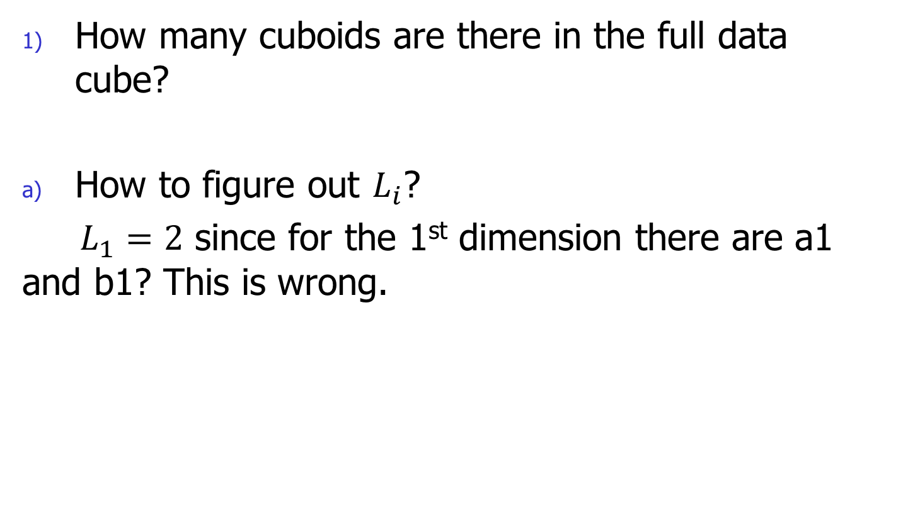
Sample Exam: Question 3
How many cuboids are there in the full data cube?
How to figure out $L_{i}$?
$L_{1}=2$ since for the 1st dimension there are a1 and b1? This is wrong.

Slide 6
Sample Exam: Question 3
1) How many cuboids are there in the full data cube?
Answer:
10 dimensions
no concept hierarchy for each dimension
Based on:
We have (1+1)^ 10 = 1024 cuboids.

Slide 7
Sample Exam: Question 3
2) How many nonempty aggregate closed cells are there in the full cube?
Closed Cell: A cell c is a closed cell if there exists no cell, d, such that d is a descendant of cell c and d has the same measure value as c.

Slide 8
Sample Exam: Question 3
2) How many nonempty aggregate closed cells are there in the full cube?
Count: Maximum count = 4
4: (∗,∗,∗,∗,a5,a6,a7,a8,a9,a10)
3: (a1,∗,∗,∗,a5,...,a10) (∗,a2,∗,∗,a5,...,a10) (∗,∗,a3,∗,a5,...,a10) (∗,∗,∗,a4,a5,...,a10)
2: (a1,a2,∗,∗,a5,...,a10) (a1,∗,a3,∗,a5,...,a10) (a1,∗,∗,a4,a5,...,a10) (∗,a2,a3,∗,a5,...,a10) (∗,a2,∗,a4,a5,...,a10) (∗,∗,a3,a4,a5,...,a10)

Slide 9
Sample Exam: Question 3
3) How many nonempty aggregate cells are there in the full cube?
a) For the last 6 dimensions, four base cells have the same pattern. Thus, we should focus on first 4 dimensions.

Slide 10
Sample Exam: Question 3
3) How many nonempty aggregate cells are there in the full cube?
b) The First 4 Dimensions
For each dimension, we have 3 options: a, b and *
E.G. for the 1st dimension, we have a1, b1 and *
Thus, we have 3^4 combinations for first 4 dimensions

Slide 11
Sample Exam: Question 3
3) How many nonempty aggregate cells are there in the full cube?
b) The First 4 Dimensions, totally 3^4
However, we found that some combinations are
empty, and we need to filter them out.
E.G. (a1,a2,a3,a4,…) (b1, a2, b3, a4,….)

Slide 12
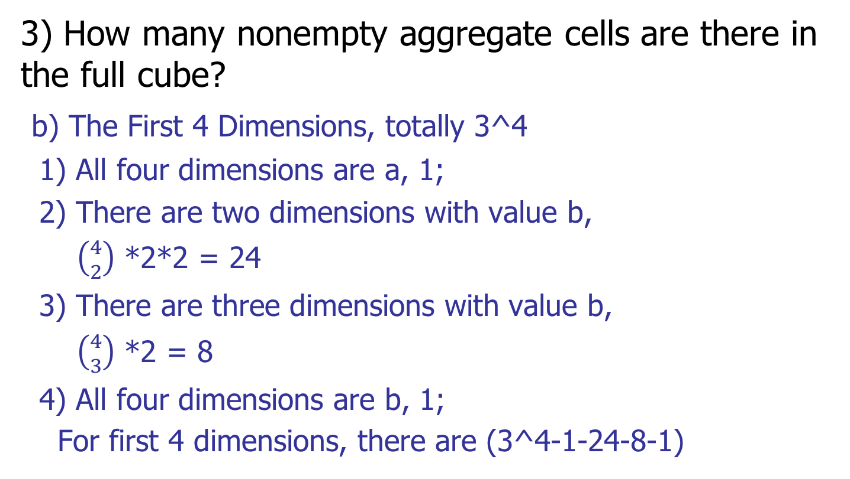
Sample Exam: Question 3
3) How many nonempty aggregate cells are there in the full cube?
b) The First 4 Dimensions, totally 3^4
1) All four dimensions are a, 1;
2) There are two dimensions with value b,
$\left({4 \atop 2}\right)$ *2*2 = 24
3) There are three dimensions with value b,
$\left({4 \atop 3}\right)$ *2 = 8
4) All four dimensions are b, 1;
For first 4 dimensions, there are (3^4-1-24-8-1)

Slide 13
Sample Exam: Question 3
3) How many nonempty aggregate cells are there in the full cube?
c) The Last 6 Dimensions, there are 2^6 combinations.
d) We have 4 base cells
Thus, we have (3^4-1-24-8-1)*2^6 – 4 in total.

Slide 14
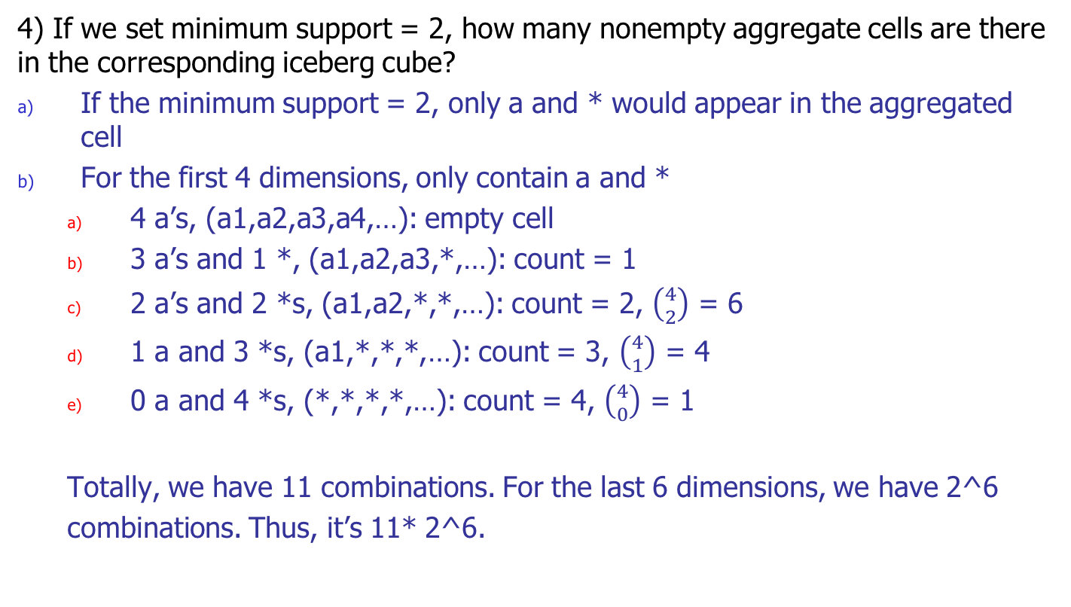
Sample Exam: Question 3
4) If we set minimum support = 2, how many nonempty aggregate cells are there in the corresponding iceberg cube?
If the minimum support = 2, only a and * would appear in the aggregated cell
For the first 4 dimensions, only contain a and *
4 a’s, (a1,a2,a3,a4,…): empty cell
3 a’s and 1 *, (a1,a2,a3,*,…): count = 1
2 a’s and 2 *s, (a1,a2,*,*,…): count = 2, $\left({4 \atop 2}\right)$ = 6
1 a and 3 *s, (a1,*,*,*,…): count = 3, $\left({4 \atop 1}\right)$ = 4
0 a and 4 *s, (*,*,*,*,…): count = 4, $\left({4 \atop 0}\right)$ = 1
Totally, we have 11 combinations. For the last 6 dimensions, we have 2^6
combinations. Thus, it’s 11* 2^6.

Slide 15
Sample Exam: Question 4
(a0,b0,c0) : 1 (a1,b1,c0) : 3 (a0,b2,c0) : 1
(a0,b0,c1) : 1 (a1,b1,c1) : 3 (a0,b2,c1) : 1
(a0,b0,c2) : 1 (a1,b1,c2) : 3 (a0,b2,c2) : 1
Draw the trace trees of expansion with regard different exploration orders: A, B, C and C, B, A, respectively.
If we set minimum support = 4 with the exploration order of A, B, C, how many cells would be considered/computed?

Slide 16
Sample Exam: Question 4
1) Draw the trace trees of expansion with regard different exploration orders: A, B, C and C, B, A, respectively.

Slide 17
Sample Exam: Question 4
2) If we set minimum support = 4 with the exploration order of A, B, C, how many cells would be considered/computed?

Slide 19
Midterm Review
Key Points in Chapter 4
Key Points in Chapter 5

Slide 20
Chapter 4: Data Warehousing and On-line Analytical Processing
Data Warehouse: Basic Concepts
Data Warehouse Modeling: Data Cube and OLAP
Data Warehouse Usage
Data Warehouse Implementation

Slide 21
Chapter 4: Data Warehousing and On-line Analytical Processing
Data Warehouse: Basic Concepts
(a) What Is a Data Warehouse?
(b) Data Warehouse: A Multi-Tiered Architecture
Data Warehouse Modeling: Data Cube and OLAP
(a) Cube: A Lattice of Cuboids
(b) Conceptual Modeling of Data Warehouses
(c) Stars, Snowflakes, and Fact Constellations: Schemas for Multidimensional Databases
(d) Dimensions: The Role of Concept Hierarchy
(e) Measures: Their Categorization and Computation: distributive, algebraic and holistic
(f) Cube Definitions in Database systems
(g) Typical OLAP Operations: drill up, drill down, slice and so on…
Data Warehouse Usage
Data Warehouse Implementation
(a) Efficient Data Cube Computation: Cube Operation, Materialization of Data Cubes, and Iceberg Cubes
(b) Efficient Processing of OLAP Queries

Slide 22
Sample Question 1
Cube ?
Cuboid ?
Cell ?
Measure: ?

Slide 23
Sample Question 1
Example:
Year vs. Dept.
Cuboid:
(Year, Dept.)
Cell: measure
(Senior, CS): 30, (Junior, CS): 20
Aggregated:
(*, CS): 50
 | CS | ECE | EDU | LAW
Senior | 30 | 40 | 20 | 25
Junior | 20 | 50 | 25 | 30

Slide 24
Sample Question 2
Concept Hierarchy ?
How many cuboids are there in the full cube?

Slide 25
Sample Exam: Question 3
Example 1: Students’ Division and their Hometown
State vs. Dept.
Cuboid: (State, Dept.)
Cells: (Illinois, CS): 30 , (Maryland, CS): 20
 | CS | ECE | Physics | Math
Illinois | 30 | 40 | 20 | 25
Maryland | 20 | 50 | 25 | 30

Slide 26
Sample Exam: Question 3
Example 2: Students’ Division and their Hometown
Cuboid: (State, Dept.), (State, School)
Cells: (Illinois, CS): 30 , (Maryland, CS): 20
(Illinois, Engineering): 70
(Illinois, Science): 45
 | Enignneering |  | Science
 | CS | ECE | Physics | Math
Illinois | 30 | 40 | 20 | 25
Maryland | 20 | 50 | 25 | 30

Slide 27
Efficient Data Cube Computation
Motivation: People expect high efficiency when querying data information
Data cube can be viewed as a lattice of cuboids
The bottom-most cuboid is the base cuboid
The top-most cuboid (apex) contains only one cell
How many cuboids in an n-dimensional cube with L levels?

Slide 28
Chapter 5: Data Cube Technology
Data Cube Computation: Preliminary Concepts
Data Cube Computation Methods
28
Notes:
28

Slide 29
Data Cube Technology: Summary
Data Cube Computation: Preliminary Concepts
Data Cube Computation Methods
Multi-Way Array Aggregation
BUC
29

Slide 30
Multi-Way Array Aggregation
Using multi-dimensional chunk to materialize cube
High Efficiency for Full Cube Computation for data set with small number of dimensions:
Simultaneous aggregation on multiple dimensions
Intermediate aggregate values are re-used for computing ancestor cuboids
No Iceberg Optimization: Cannot Apriori Prunning
30

Slide 31
BUC
Introduction: • BUC (Beyer & Ramakrishnan, SIGMOD’99) • Bottom-Up cube computation
(Note: Top-Down in our view!)
Partition and Optimization: Divides dimensions into partitions and
facilitates iceberg pruning
If a partition does not satisfy min_sup, its descendants can be pruned
No simultaneous aggregation: Difference to Multi-Way Array Aggregation
31

